Slide 1
Humor Styles Questionnaire Study
Jessica Fong
CSC570
Final Project

Slide 2
Background
The Humor Styles Questionnaire (HSQ) was developed by Rod Martin and Patricia Doris (2003) to measure individual differences in styles of humor
The Humor Styles Questionnaire is a 32-item self-report inventory used to identify how individuals use humor in their lives
The questionnaire measures two main factors in humor. The first factor measures whether humor is used to enhance the self or enhance one's relationships with others. The second factor measures whether the humor is relatively benevolent or potentially detrimental and destructive. The combination of these factors creates four distinct humor styles: affiliative, self-enhancing, aggressive, and self-defeating.

Slide 3
Sample questions
On a scale of 1 to 5, answer the following questions:
Q1. I usually don’t laugh or joke around much with other people.
Q2. If I am feeling depressed, I can usually cheer myself up with humor.
Q3. If someone makes a mistake, I will often tease them about it.
Q4. I let people laugh at me or make fun at my expense more than I should.
Q5. I don’t have to work very hard at making other people laugh—I seem to be a naturally humorous person.
Q6. Even when I’m by myself, I’m often amused by the absurdities of life.

Slide 4
Other questions
Age – entered as text then parsed to an integer
Gender – chosen from drop down list (1=male, 2=female, 3=other)
Accuracy – how accurate they thought their answers were on a scale from 0 to 100, answers were entered as text and parsed to an integer. They were instructed to enter a 0 if they did not want to be included in research.

Slide 5
Styles of humor
Four styles of humor are calculated after the user completes the questionnaire:
Affiliative humor – a style of humor used to enhance one’s relationships with others in a benevolent, positive manner
Self-enhancing humor – a style of humor related to having a good-natured attitude toward life, having the ability to laugh at yourself, your circumstances and the idiosyncrasies of life in constructive, non-detrimental manner.
Aggressive humor – a style of humor that is potentially detrimental towards others. This type of humor is characterized by the use of sarcasm, teasing, criticism, ridicule, etc at the expense of others
Self-defeating humor – a style of humor with the use of potentially detrimental humor towards the self in order to gain approval from others

Slide 6
Data Analysis overview
Raw data was obtained from
http://personality-testing.info/_rawdata/
There were 1071 completed questionnaires in the study
Out of those, 985 were used in this analysis as some of them contain invalid data
The male vs female participation was roughly 55% to 45%
The age group ranged from 14 to 70 years old
The self rated accuracy ranged from 7 to 100

Slide 7
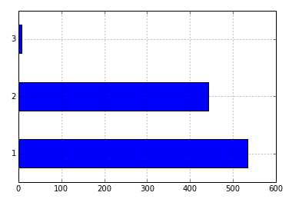
Gender distribution (1=male, 2=female, 3=other)
Gender Category
no. of participants

Slide 8
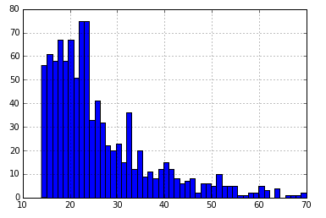
Age distribution
no. of participants
age (years)

Slide 9
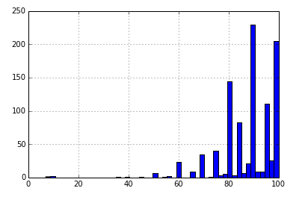
Self-rated accuracy distribution
no. of participants
self-rated accuracy

Slide 10
Prediction on gender
Analysis model was implemented using Random Forest Regressor
The model was fine tuned to achieve higher ROC
The ROC has a score of 0.66, which seems relatively low.
Prediction on gender based on the questions answer is not very accurate (accuracy score = 0.64)
GridSearch was also used with no improvement in the ROC

Slide 11
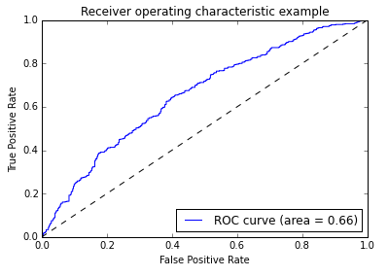
Prediction on gender - ROC

Slide 12
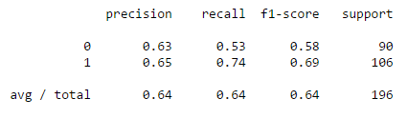

Prediction on gender – Precision/Recall
Confusion Matrix

Slide 13
Linear Regression
Attempted to predict self rated accuracy by linear regression using age and the four humor styles (affiliative, self enhancing, aggressive, self defeating) which was calculated by the study
The linear regression score was 0.001139, which was very low
It appears that self rated accuracy cannot be predicted based on these features
Also attempted to predict age based on the positive humor styles (affiliative and self enhancing) which also yielded a low linear regression score

Slide 14
Summary
While the model implemented had a ROC score of 0.66, it is still higher than the male vs female percentage (55% vs 45%). It appears that there is some correlation between humor styles and gender

Slide 15
Reference(s)
https://www.hnu.edu/ishs/ISHS%20Test%20Bank/TestCat_HSQ.htm
http://en.wikipedia.org/wiki/Humor_styles#cite_note-Martin-2

